Slide 1

The Battle of Neighborhoods - Final Report
Coursera Capstone Athens Project

Slide 2
Discussion of the business problem
Scenario and Background
I currently live within walking distance from "Megaro Mousikis metro station" near the center of Athens therefore I have access to good public transportation to work. Likewise, I enjoy many amenities in the neighborhood , such as international cousine restaurants, cafes, food shops and entertainment. I have just recently started looking for a bigger house for a family.
Problem to be resolved
The challenge to resolve is being able to find a rental apartment unit in Attica GR that offers similar characteristics and benefits to my current situation. Therefore, in order to set a basis for comparison, I want to find a rental unit subject to the following conditions:
Apartment with min 2 bedrooms with monthly rent not to exceed 700 euro/month
Unit located within walking distance (<= 1.5 km) from a subway metro station in Attica
Area with amenities and venues similar to the ones described for current location
Interested Audience
I believe this is a relevant project for everyone considering moving to a major city in Europe, US or Asia, since the approach and methodologies used here are applicable in all cases. The use of FourSquare data and mapping techniques combined with data analysis will help resolve the key questions arisen. Lastly, this project is a good practical case towards the development of Data Science skills.

Slide 3
Data Section
Data of Current Situation
I currently reside in the neighborhood of 'Kolonaki' near Athens city center. Foursquare will be used to identify the venues around the area of residence which will be shown in Athens map. It serves as a reference for comparison with the desired future location.
Data Required to resolve the problem
In order to make a good choice of a similar apartment, the following data is required: List/Information of Attica neighborhoods with their geodata (latitude and longitude). List/Information of the subway metro stations with Geodata. Listed apartments for rent in Athens area with descriptions (number of bedrooms, apartment size, price, location). Venues and amenities in Athens neighborhoods (e.g. top 10).
How the data will be used to solve the problem
The data will be used as follows: Use Foursquare and geopy data to map top 10 venues for all Athens neighborhoods and clustered in groups. Use foursquare and geopy data to map the location of subway metro stations, separately and on top of the above clustered map in order to be able to identify the venues and amenities near each metro station, or explore each subway location separately. Use Foursquare and geopy data to map the location of rental places, in some form, linked to the subway locations. Create a map that depicts, for instance, the average rental price per square ft, around a radius of 1.5 km around each subway station. I will be able to quickly point to the popups to know the relative price per subway area.

Slide 4
Sources and manipulation
The list of Athens neighborhoods is scraped from Wikipedia link https://en.wikipedia.org/wiki/Category:Neighbourhoods_in_Athens and is passed to a list and then to the pandas DataFrame "df_neighborhoods" along with latitude and longitude retrieved from Nominatim.
A list of Athens subway metro stations was scraped once again from Wikipedia (https://en.wikipedia.org/wiki/List_of_Athens_Metro_stations). The geolocation was obtained again using Nominatim and passed to the pandas DataFrame "df_stations".
A list of places for rent was collected by web-browsing nepstick site: https://www.nestpick.com/athens/ working as search engine for rental apartments, retrieving data from different real etate sites. Afterwards data are passed to a DataFrame with the following columns ['name', 'category', 'normalized_price', 'number_of_bedrooms', 'apartment_size', 'latitude', 'longitude']. The loop algorithms used are shown in the execution of data. "Great_circle" function from geolocator was used to calculate distances between two points, as in this case to calculate average rent price for units around each subway station and at 1.5 km radius. Foursquare is used to find the avenues at Athens neighborhoods in general and a cluster is created to later be able to search for the venues depending on the location shown.

Slide 5
The analysis and the strategy
The strategy is based on mapping the above described data in section 2.0, in order to facilitate the choice of at least two candidate places for rent. The choice is made based on the demands imposed: location near a subway, rental price and similar venues to the current location. This visual approach and maps with popup labels allow quick identification of location, price and feature, thus making the selection very easy.
The processing of these data and its mapping will allow to answer the key questions to make a decision:
What is the cost of available rental places that meet the demands?
What is the cost of rent around 1.5 km radius from each subway metro station?
What is the area of Athens with best rental pricing that meets criteria established?
What is the distance from work place and the tentative future rental home?
What are the venues of the two best places to live? How the prices compare?
How venues distribute among Athens neighborhoods and around metro stations?
Are there tradeoffs between size and price and location?
Any other interesting statistical data findings of the real estate and overall data.

Slide 6
Athens Map - Current residence and venues in neighborhood

Slide 7
ATHENS NEIGHBORHOODS - MAPPING
The resulting clusters are visualized on the Athens map according to the top ten venues of each neighborhood with the help of Foursquare Api.

Slide 8
Map of Athens places for rent
The data of the rental houses are directly retrieved by scraping Nepstick site along with the latitude and longitude of each house.

Slide 9
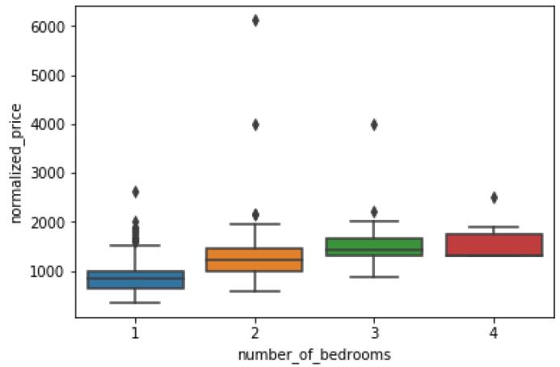
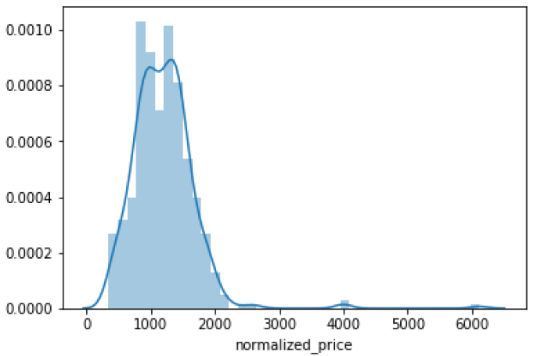
Examining the prices

Slide 10
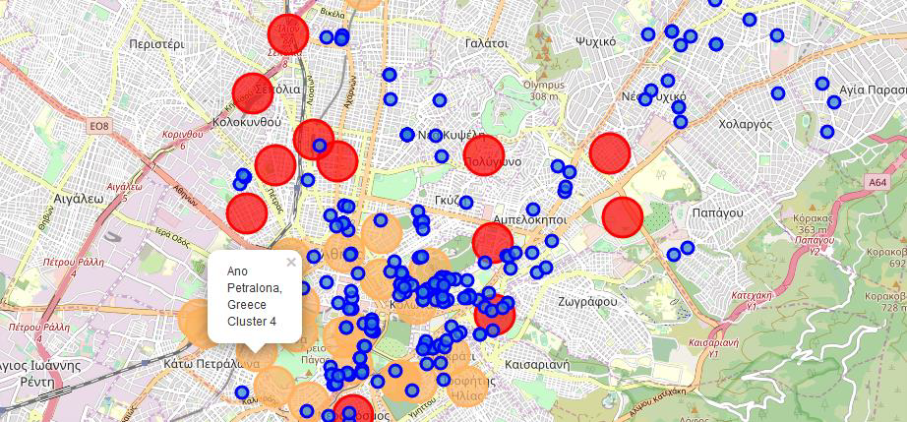
Map of Athens showing the places for rent and the cluster of venues

Slide 11
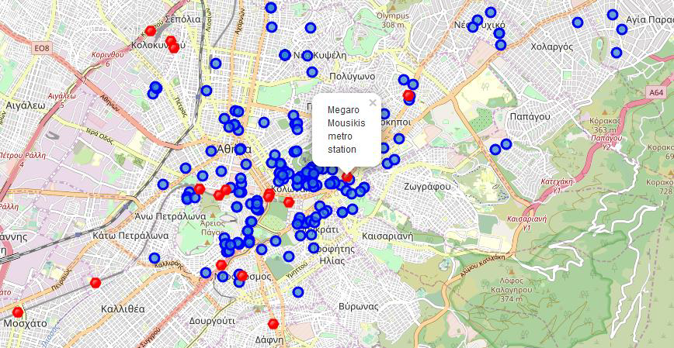
Map of Athens showing places for rent and the subway locations nearby

Slide 12
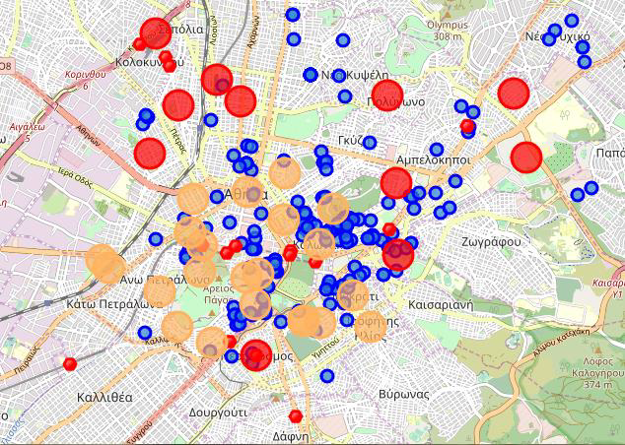
ONE CONSOLIDATE MAP
Let's consolidate all the required information to make the apartment selection in one map.
Red dots are Subway stations, Blue dots are apartments available for rent, Bubbles are the clusters of venues.

Slide 13
FINAL CHOICE
After examining, I have chosen two locations that meet the requirements which will assess to make a choice.
Apartment 1: 10 Geometrou Theodorou Street in the Neos Kosmos Neighborhood and near 'Neos Kosmos' metro station, Cluster # 0 Monthly rent : 650 Euros
Apartment 2: 19 Nikis Street between Plaka and Kolonaki Neighborhoods and near 'Syntagma' metro station, Cluster # 4 Monthly rent : 590 Euros
Using the "one map" above, I was able to explore all possibilities since the popups provide the information needed for a good decision.
Based on current residence venues, I feel that Cluster 4 type of venues is a closer resemblance to my current place. That means that APARTMENT 2 is clear winner.

